Slide 1
Wireless Personal Area Network WPAN

Slide 2
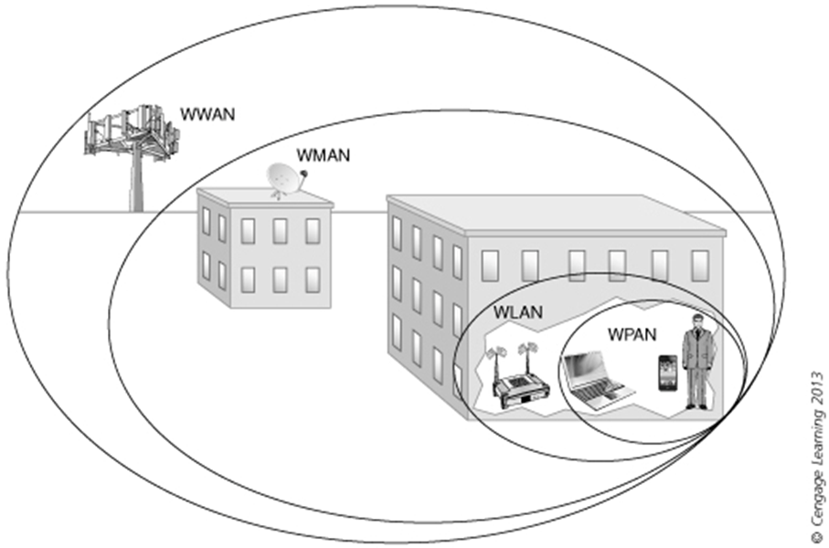
WPAN and Wireless Networks

Slide 3
Wireless Personal Area Network
A WPAN (wireless personal area network) is a personal wireless area network for interconnecting devices centered around an individual person's workspace - in which the connections are wireless. WPAN uses some technology that permits communications in a very short range (10 m).
IEEE 802.15 Standards

Slide 4
WPAN 802.15
Uses ISM Unlicensed Spectrum for Wireless Networks (Industrial, Scientific and Medical band)
Uses 2.4 GHz band
WPAN Main Technology:
  Bluetooth
  Infrared
  RFID
  NFC
  Zigbee

Slide 5
Wireless Personal Area Networks
A WPAN can be used for communications among the personal devices themselves.
A WPAN usually has an ad-hoc topology. Master–slave mode and mesh mode are the two types of ad-hoc networks that can be applied for WPANs.
  A master–slave ad-hoc network consists of a master node and multiple slave nodes. The master node defines a cell or piconet. The slave nodes within the piconet connect to the master device.
  Some WPANs apply mesh mode, where nodes are interconnected with wireless links without forming a specific cell or piconet

Slide 6
Master and Slave Ad-Hoc Mode

Slide 7
Bluetooth
History
  1998 – Its primary purpose is to be a wire replacement technology in order to transfer voice and data.
  1999 – Bluetooth 1.0 100 m range
  2004 – Bluetooth 2.0 +EDR (Enhanced Data Rate).
  2009 – Bluetooth 3.0 + HS (High Speed).
  2010 – Bluetooth 4.0 + BLE (Bluetooth Low Energy), IPv6
  2016 – Bluetooth 5.0 400 m range, 2x speed, IoT

Slide 8
Major Evolution of Bluetooth Versions
Version | V1.1 | V1.2 | V2.0/V2.1 | V3.0 | V4.0 | V5.0
Date | 2001/02 | 2003/11 | 2004/11 2007/07 | 2009/04 | 2009/12 | 2016/12
Data rate | 732.2 Kbps | 1 Mbps | 2.1 Mbps | 24 Mbps | 2.1/24 Mbps | 2 Mbps
Major features | Signal strength indication | Adaptive frequency hopping | Enhanced data rate (EDR) | High speed channel | Low energy protocol | High spectral efficiency

Slide 9
Bluetooth Applications
Connecting devices: Bluetooth can help you connect to wireless devices such as speakers, headphones, fitness trackers, keyboards, and smart home devices.
File sharing: Bluetooth allows you to wirelessly share different types of files, including photos, music, and videos.
Hotspot tethering: Using Bluetooth can help you turn your mobile device into a Wi-Fi hotspot, allowing you to share your internet.
Security: Certain computers and home security systems may connect to your phone using Bluetooth, allowing you to use it as a key to unlock your house or other security devices.

Slide 10
Bluetooth Attack Types
Bluesnarfing: happens when a hacker pairs with your Bluetooth device without your knowledge and steals or compromises your personal data. This attack does not provide control over the device, but leaks the information.
Bluebugging: This is one of the most harmful attacks, granting that the attacker fully controls over the victim’s device. Through this attack, the hacker can control the calls and messages, fetch the contacts and other information.

Slide 11
Bluetooth Attack Types
BlueSmacking: This type of attack is almost inoffensive, and consists of disabling the victim’s mobile bluetooth services by sending a large amount of big packets to generate a service overload.
Bluejacking is when a Bluetooth device sends unsolicited spam and phishing messages to another Bluetooth device. In addition to being annoying, these messages may also contain malicious links and attachments that might include malware.

Slide 12
Bluetooth Security Tips
Keep your operating system up to date
Make sure your device is not discoverable
Avoid sharing sensitive information over Bluetooth
Turn Bluetooth off when not in use
Don’t set up pairing in public

Slide 13
NFC WPAN
NFC (Near Field Communications) was introduced in the early 2000s, uses a specific RFID frequency (13.56MHz) which enables two devices to communicate wirelessly when they’re close together.
NFC is a set of standards for smart-phones or whatever to establish communication with each other by bringing them into close together (0-5 centimetres).
- NFC rates ranging from 106 Kbps – 424 Kbps.
- NFC involves an initiator and a target

Slide 14
NFC WPAN
There are two NFC operational modes:
Passive communication mode: The initiator device provides a carrier fields and the target device answers by modulating the existing field. The Passive Devices has no power source and it connects with the active devices.
Active communication mode: Both initiator and target device communicate by alternately generating their own fields. A device stops transmitting in order to receive data from the other.

Slide 15
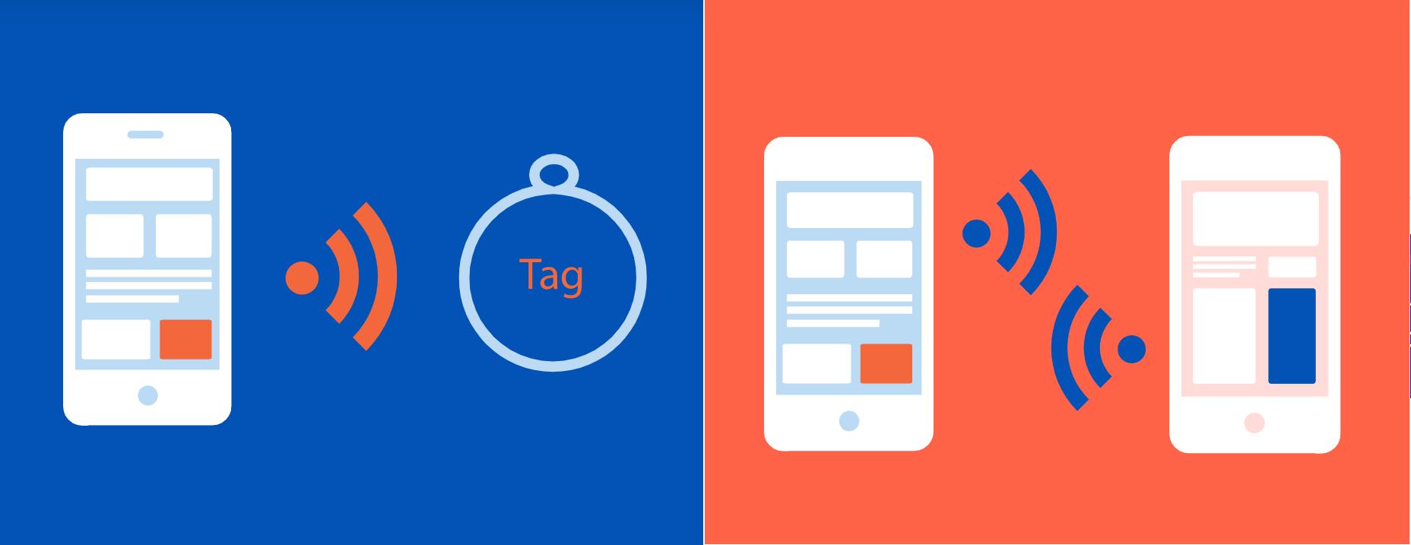
Passive Operation Vs Active Operation

Slide 16
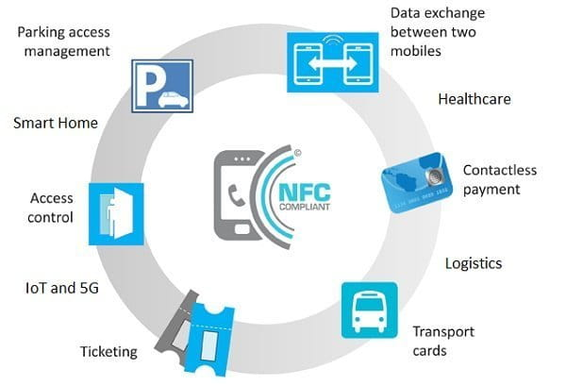
NFC Applications

Slide 17
NFC Security
NFC uses 128-bit AES or higher encryption to guarantee security and privacy of transactions. Because NFC uses tokenization instead of storing credit card information, for example, no retailer can see your credit card number.
Payment tokenization is a method of securing digital payment by replacing the cardholder’s information with an algorithmically generated number called a token. Tokenization is also a critical solution to prevent card fraud.

